Slide 1

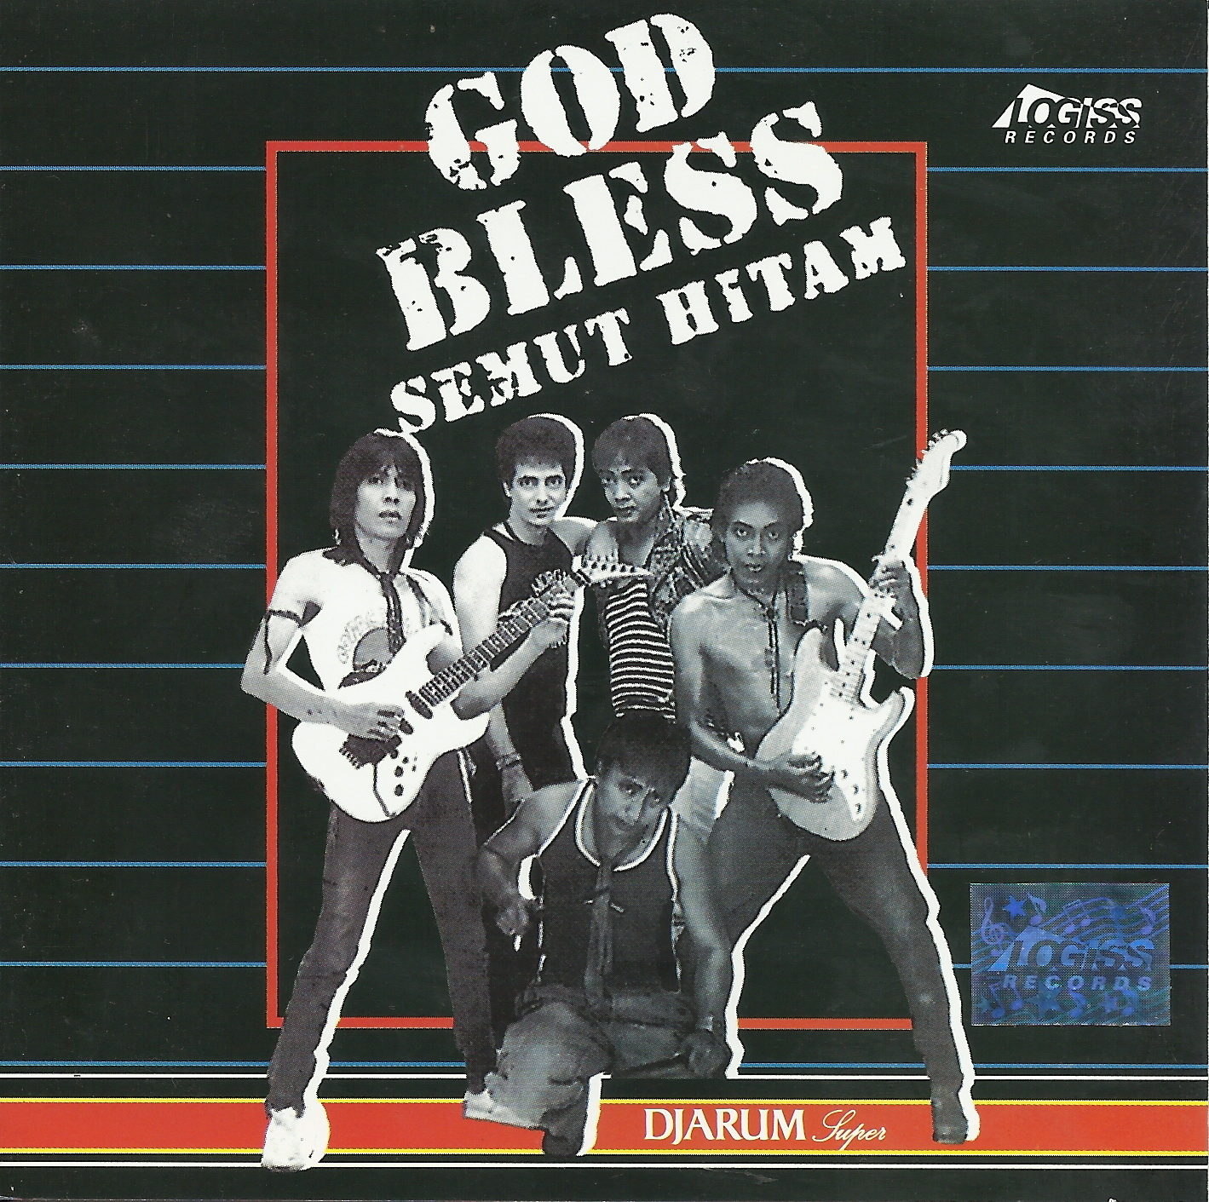

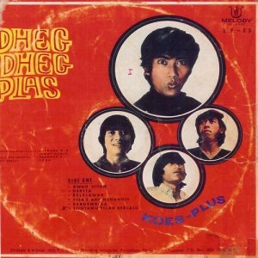
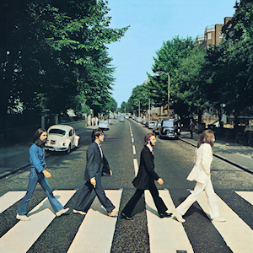
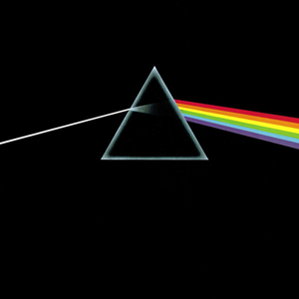

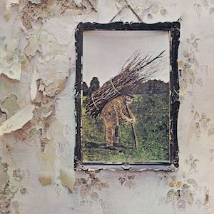
MAKING MUSIC WITH GNOME TM

Slide 2
Hello ...
Kukuh Syafaat
  Session Musician
  GNU/Linux Enthusiast
  BlankOn (Indonesian Debian-based GNU/Linux Distribution) Developer
  Currently work at local startup as UI/UX Designer
  cho2@di.blankon.in // syafaatkukuh@gmail.com
  @cho2MLHC

Slide 3
You need...
Hardware
Software
Brainware :D

Slide 4
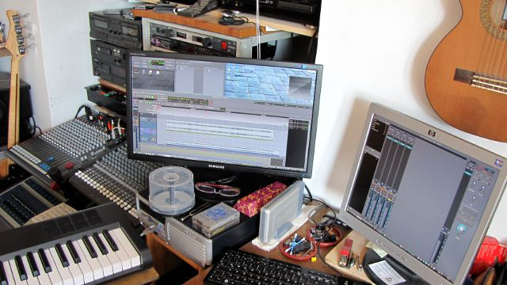
Hardware
Computer

Slide 5
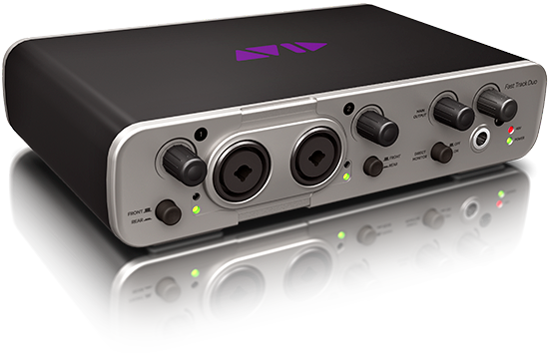
Hardware (2)
USB Soundcard

Slide 6
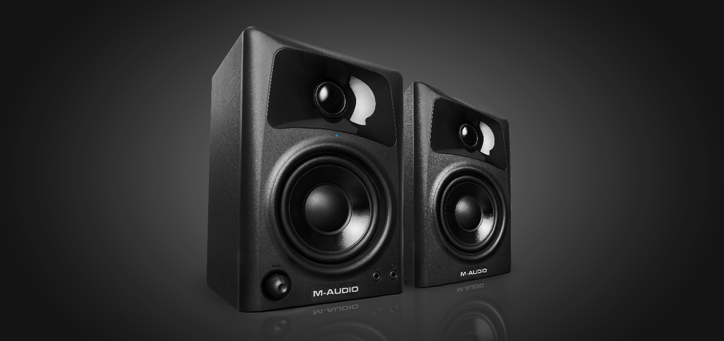
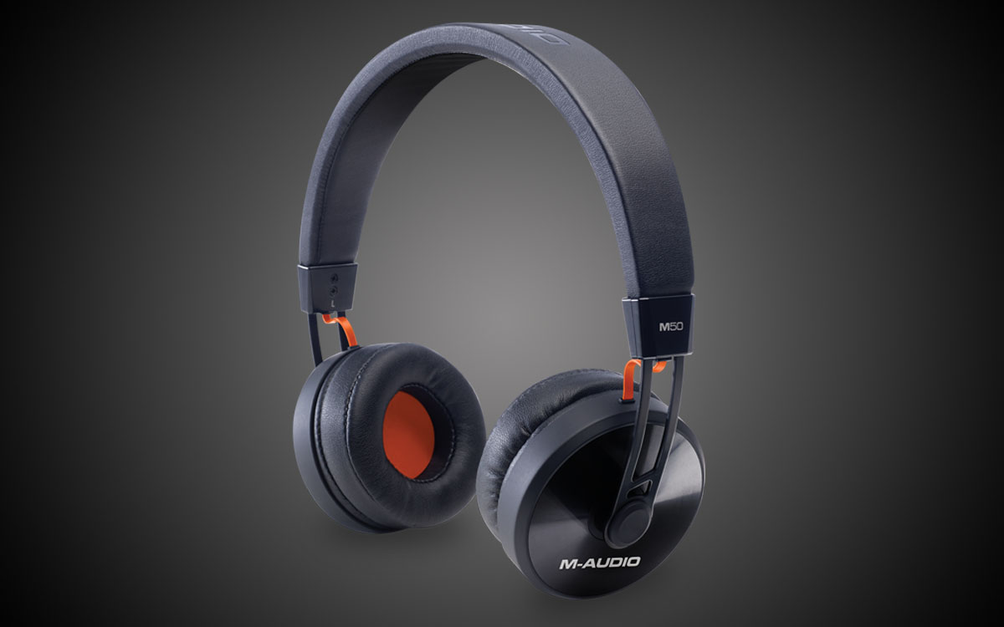
Hardware (3)
Monitor Speaker/Headphone

Slide 7
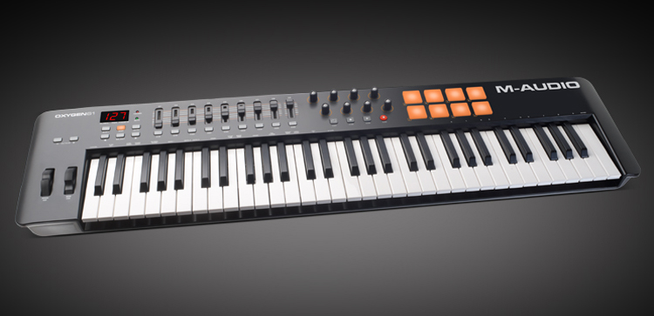
Hardware (4)
USB Keyboard Controller

Slide 8
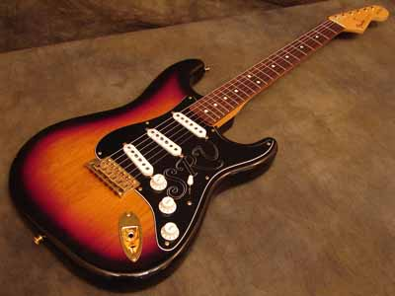
Hardware (5)
Music Instruments

Slide 9
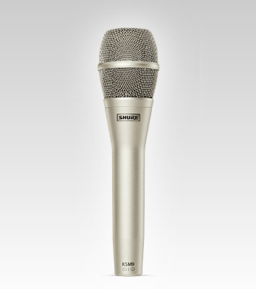
Hardware (6)
Microphone

Slide 10
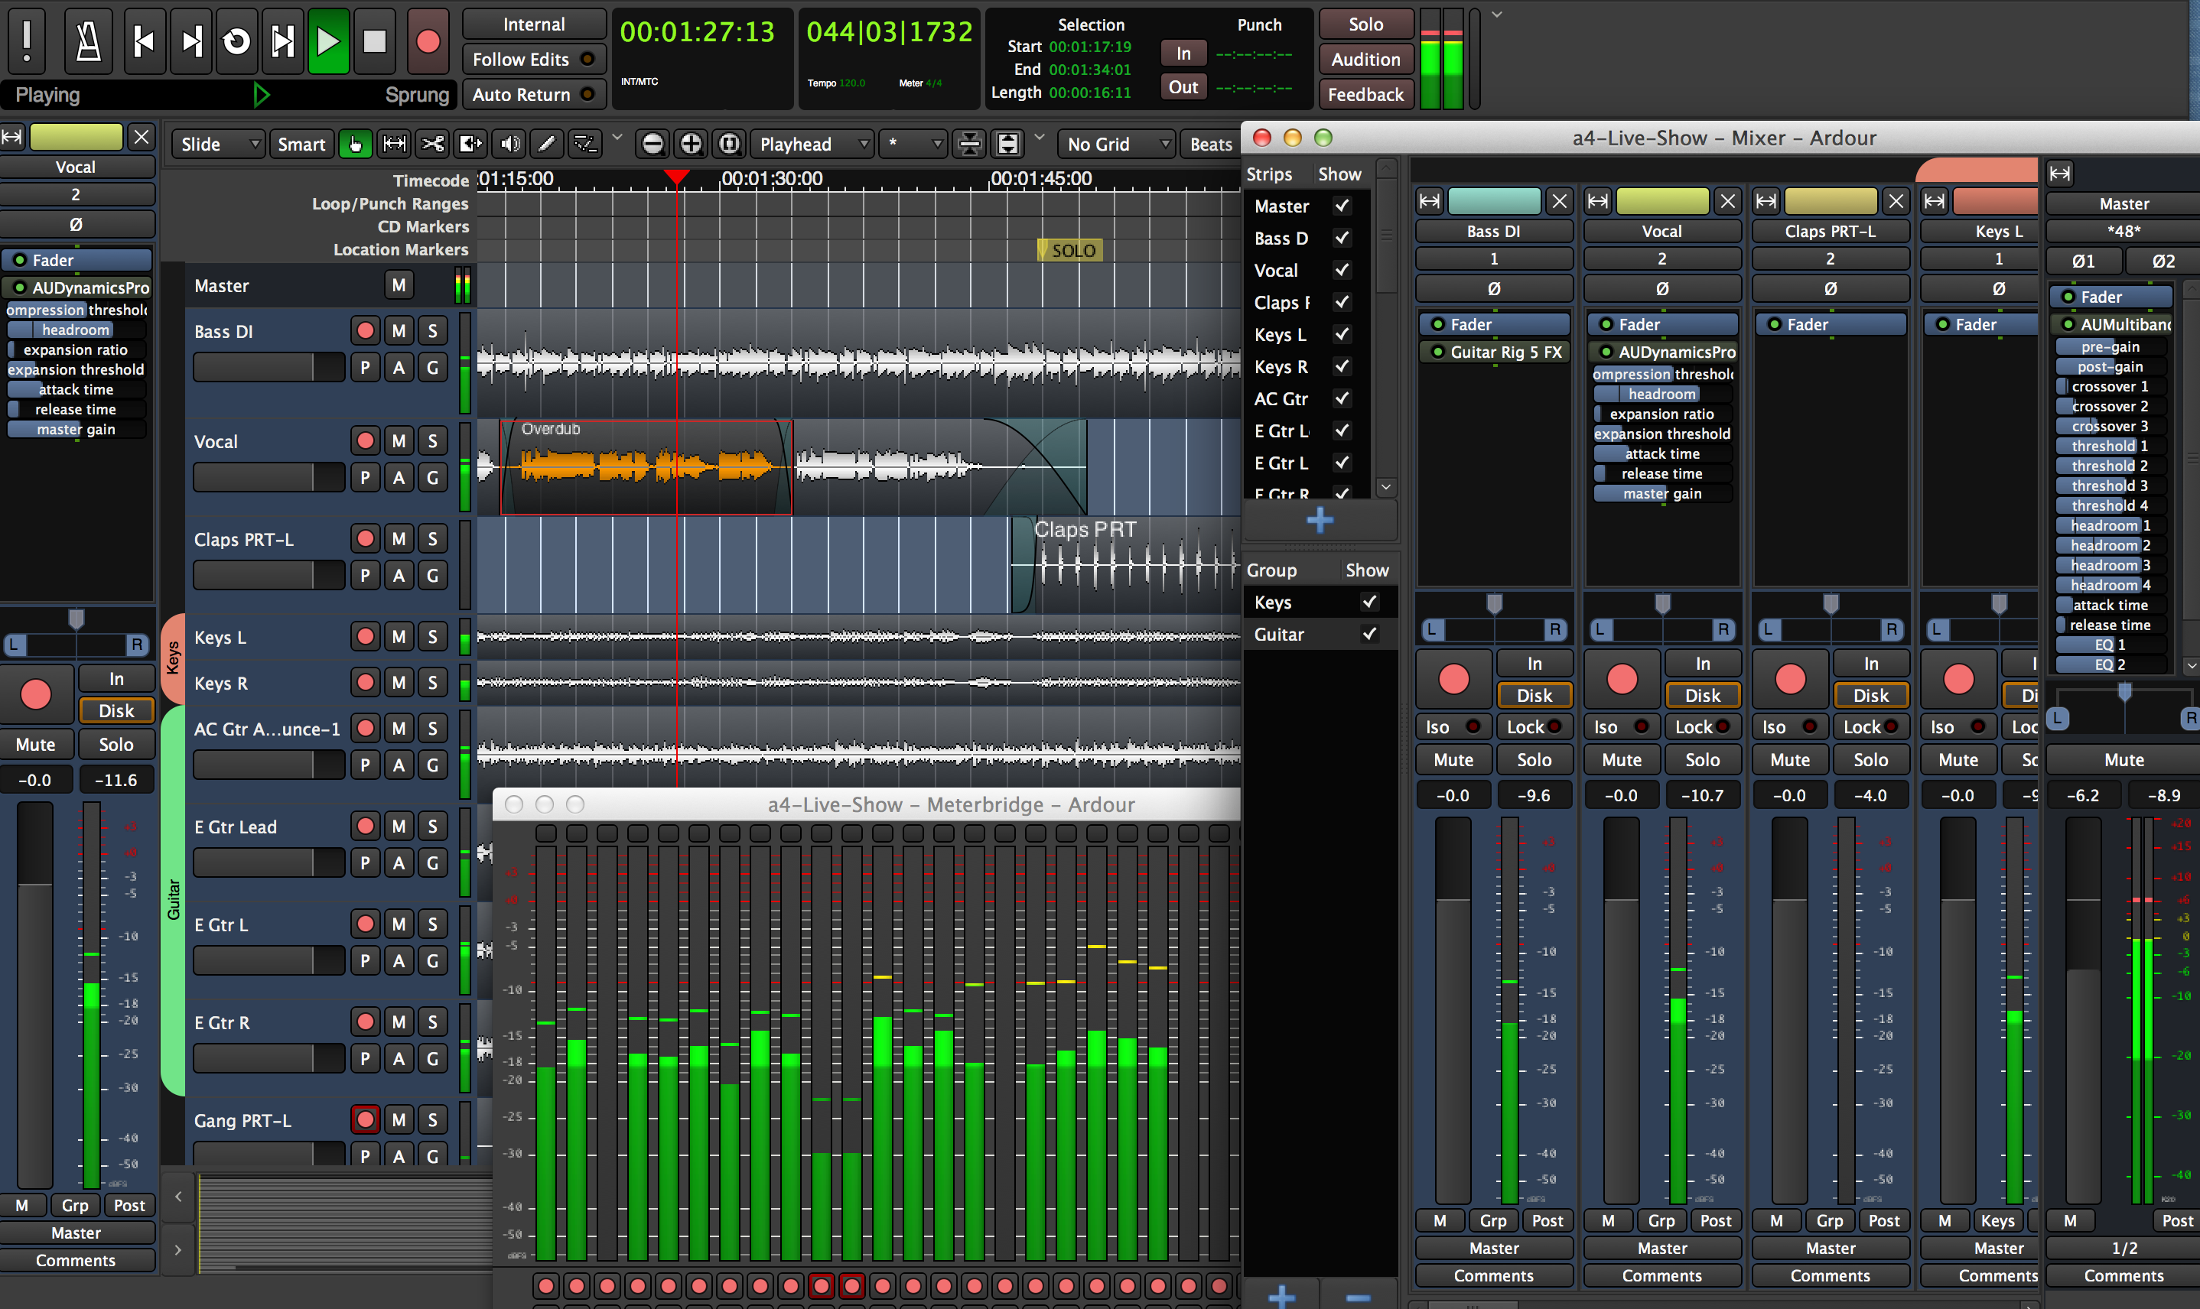
Software
Ardour
  Digital audio workstation.
  (http://ardour.org/)

Slide 11

Software (2)
JACK
  Audio connection kit
  (http://jackaudio.org/)

Slide 12
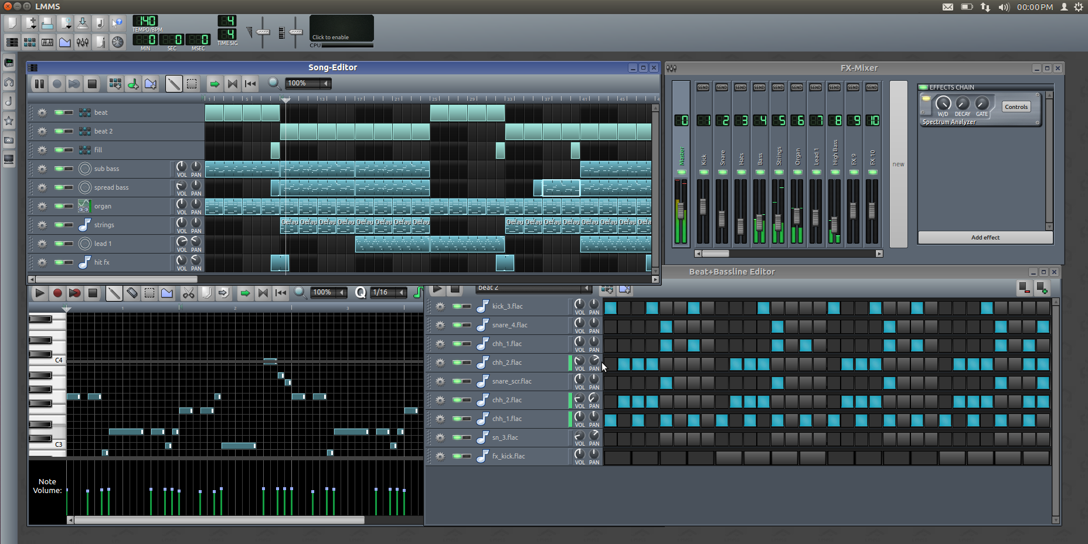
Software (3)
LMMS
  Free cross-platform alternative to commercial programs like FL Studio®, which allow you to produce music with your computer.
  (https://lmms.io/)

Slide 13
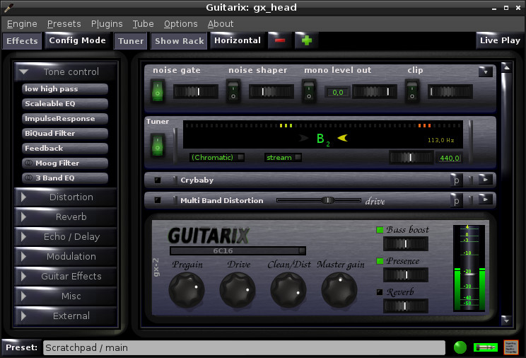
Software (4)
Guitarix
  Simple Linux amplifier with one input and two outputs.
  (http://guitarix.org/)

Slide 14
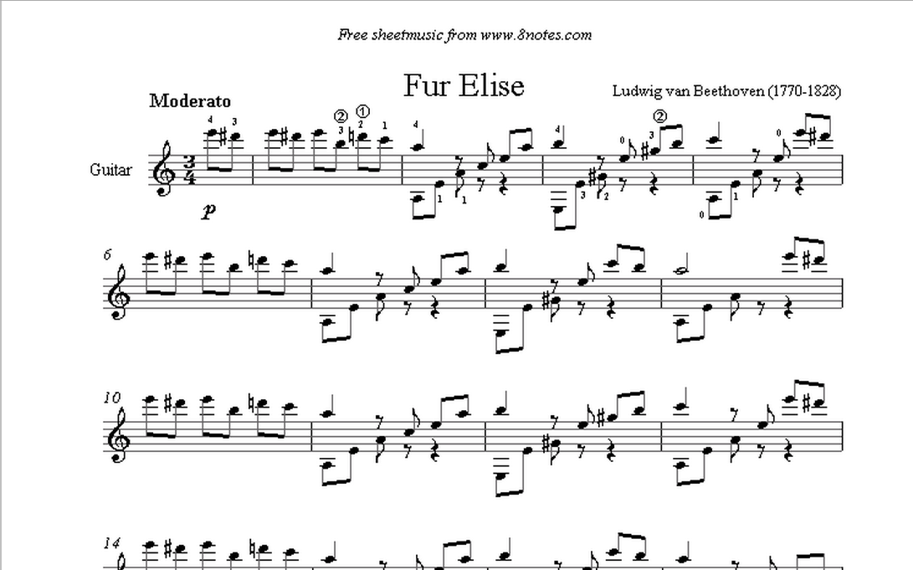
Brainware
Basic music theory

Slide 15
Basic Recording Step
Tracking
  Recording an instrument
Mixing
  The process by which multiple sounds are combined into one or more channels
Mastering
  Preparing and transferring recorded audio from a source containing the final mix to a data storage device (the master)

Slide 16
DEMO

Slide 17
Q&A

Slide 18
Thank You

